Slide 1
Chapter 15 : Concurrency Control

Slide 2
Chapter 15: Concurrency Control
Isolation
  The fundamental properties of a transaction
When several transactions execute concurrently in the database
  The isolation property may no longer be preserved
    So, the system must control the interaction among the concurrent transactions
  The control is achieved through mechanism called concurrency control schemes

Slide 3
Concurrency Control vs. Serializability Tests
Testing a schedule for serializability after it has executed is a little too late!
Goal – To develop concurrency control protocols that will assure serializability
  They will generally not examine the precedence graph as it is being created
  Instead a protocol will impose a discipline that avoids nonserializable schedules
Require study of concurrency protocols
Tests for serializability help understand why a concurrency control protocol is correct

Slide 4
Chapter 15: Concurrency Control
Lock-Based Protocols
Timestamp-Based Protocols
Validation-Based Protocols
Multiple Granularity
Multiversion Schemes
Insert and Delete Operations
Concurrency in Index Structures
Most frequently used schemes
  Two-Phase Locking
  Snapshot Isolation

Slide 5
Lock-Based Protocols
A lock is a mechanism to control concurrent access to a data item
  To allow MULTIPLE transactions to READ a data item
  But, limits WRITE access to just ONE transaction at a time
Every transaction require a lock on data item Q in an appropriate mode depending upon the type of operations it will perform on the data item Q
What will make lock request to where?
  Transaction makes Lock requests to concurrency-control manager
Transaction can proceed only after request is granted

Slide 6
Lock-Based Protocols
Data items can be locked by transaction in two modes
1. Exclusive (X) mode
Data item Q can be both read as well as written
X-lock is requested using lock-X(Q) instruction
2. Shared (S) mode
Data item can only be read
S-lock is requested using lock-S(Q) instruction
To unlock a data item Q using Unlock(Q) instruction

Slide 7

Lock-Based Protocols (Cont.)
Lock-compatibility matrix
A transaction may be granted a lock on an item if the requested lock is COMPATIBLE with locks already held on the item by other transactions

Slide 8
Lock-Based Protocols (Cont.)
Lock-compatibility matrix
ANY NUMBER of transactions can hold SHARED locks on an item,
But if any transaction HOLDS AD EXCLUSIVE on the item NO OTHER TRANSACTION may hold any lock on the item
If a lock cannot be granted,
  The requesting transaction is made to wait till all incompatible locks held by other transactions have been released,
  Then only the lock is granted

Slide 9
Lock-Based Protocols
Transaction 1
Transaction 2
Banking Example
T1 transfers $50 from Acct B to Acct A
T2 displays the total money in Acct A and B
A=$100
B=$200
If schedule,
  T1→T2, then A+B=300
  T2→T1, then A+B=300
Now, add lock information
read (B)
    B=B-50
    write (B)
    read (A)
    A=A+50
    write (A)
read (A)
    read (B)
    Display (A+B)

Slide 10
Lock-Based Protocols
Transaction 1
Transaction 2
Banking Example
T1 transfers $50 from Acct B to Acct A
T2 displays the total money in Acct A and B
A=$100
B=$200
If schedule,
  T1→T2, then A+B=300
  T2→T1, then A+B=300
lock-X(B)
read (B)
    B=B-50
    write (B)
    unlock (B)
    lock-X(A)
    read (A)
    A=A+50
    write (A)
    unlock (A)
lock-S(A)
read (A)
    unlock (A)
    lock-S(B)
    read (B)
    unlock (B)
    Display (A+B)

Slide 11
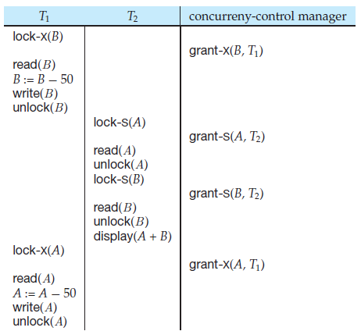
Lock-Based Protocols
Shows points at which the concurrency-control manager grants the locks
The transaction making a lock request cannot execute its next action until the concurrency control manager grants the lock
Hence, the lock must be granted in the interval of time between the lock-request operation and the following action of the transaction
Schedule 1

Slide 12
Lock-Based Protocols
Transactions are executed concurrently
T2 displays $250
  As T1 unlocked data item B too early
  Inconsistent state
Schedule 1

Slide 13
Lock-Based Protocols
Transaction 3
Transaction 4
Banking Example (UNLOCKING DELAYED)
T3 transfers $50 from Acct B to Acct A
T4 displays the total money in Acct A and B
A=$100
B=$200
No possibility of incorrect display of total $250
Consistent state
lock-X(B)
read (B)
    B=B-50
    write (B)
    lock-X(A)
    read (A)
    A=A+50
    write (A)
    unlock (B)
    unlock (A)
lock-S(A)
read (A)
    lock-S(B)
    read (B)
    Display (A+B)
    unlock (A)
    unlock (B)

Slide 14

Pitfalls of Lock-Based Protocols
Consider the partial schedule
Neither T₃ nor T₄ can make progress — executing
  lock-S(B) causes T₄ to wait for T₃ to release its lock on B, while
  lock-X(A) causes T₃ to wait for T₄ to release its lock on A
Such a situation is called a deadlock

Slide 15
Pitfalls of Lock-Based Protocols
Solution to deadlock
  To handle a deadlock one of the two transactions (T₃ or T₄ ) must ROLL BACK and release locks of that transaction
The potential for deadlock exists in most locking protocols

Slide 16
Pitfalls of Lock-Based Protocols (Cont.)
Example:
    A sequence of transactions that each requests a S-lock on the data item and each transactions releases the lock a short while after it is granted, but T_{x} never gets the X-lock on the data item
      The Transaction T_{x} may never make progress, and said to be starved
    Starvation
      A transaction may be waiting for an X-lock on an item, while a sequence of other transactions request and are granted an S-lock on the same item
    The same transaction T_{x} is repeatedly rolled back due to deadlocks
  Concurrency control manager can be designed to prevent starvation

Slide 17
Prevent Starvation
Avoid starvation of transactions by granting locks as shown
  When a transaction Ti requests a lock on a data item Q in a particular mode M, the concurrency-control manager grants the lock provided that:
  1. There is no other transaction holding a lock on Q in a mode that conflicts with M
    2. There is no other transaction that is waiting for a lock on Q and that made its lock request before Ti
  Thus, a lock request will never get blocked by a lock request that is made later

Slide 18
Lock-Based Protocols (Cont.)
Example of a transaction performing locking:
T₂: lock-S(A);
read (A);
unlock(A);
lock-S(B);
read (B);
unlock(B);
display(A+B)
Locking is not sufficient to guarantee serializability
  if A and B get updated in-between the read of A and B, the displayed sum would be wrong
A locking protocol is a set of rules followed by all transactions while requesting and releasing locks

Slide 19
Lock-Based Protocols (Cont.)
Locking protocols
  Restrict the set of possible schedules
  The set of all such schedules is a proper subset of all possible serializable schedules
  Allow only conflict serializable schedule

Slide 20
Two-Phase Locking Protocol
A protocol which ensures conflict-serializable schedules
Requires two phases
  Phase 1: Growing Phase
    Transaction may obtain locks
    Transaction may not release locks
  Phase 2: Shrinking Phase
    Transaction may release locks
    Transaction may not obtain locks

Slide 21
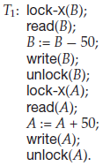
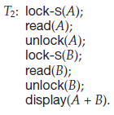
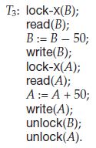
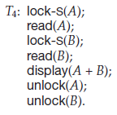
Check Transaction for Two-Phase Locking Property
Transactions T1 and T2 are not two phase, here mix of lock and unlock
While, Transactions T3 and T4 are two phase, as all locks first and then all unlock
  Clear boundary where the transaction has obtained its final lock (the end of its growing phase) is known as lock point (a point of final lock)

Slide 22
Check Transaction for Two-Phase Locking Property
The unlock instructions do not need to appear at the end of the transaction
For example, in the case of transaction T3, we could move the unlock(B) instruction to just after the lock-X(A) instruction, and still retain the two-phase locking property

Slide 23
Two-Phase Locking Protocol
The protocol assures serializability
  Can be proved that the transactions can be serialized in the order of their lock points (i.e. the point where a transaction acquired its final lock → the end of its growing phase)
    Now, transactions can be ordered according to their lock points—this ordering is, in fact, a serializability ordering for the transactions

Slide 24
Two-Phase Locking Protocol
The protocol assures serializability, BUT NOT ENSURE FREEDOM FROM DEADLOCK
  As growing phase is there (only lock instructions for one transaction) but at the same time other transaction is also requesting the same way

Slide 25
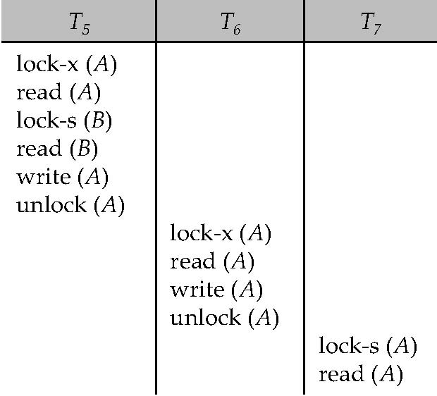
Two-Phase Locking Protocol
To being serializable schedule, schedules should be cascadeless
But, cascading rollback may occur
Here in this schedule, the failure of T₅ after the read(A) step of T₇ leads to cascading rollback of T₆ and T₇

Slide 26
The Two-Phase Locking Protocol (Cont.)
Pitfalls
  Does not ensure freedom from deadlocks
  Cascading roll-back is possible
Solution to Two-Phase Locking Protocol (Used commercially)
  Strict two-phase locking is a modified protocol
    Transaction must hold all its Exclusive locks till it commits/aborts
    Preventing any other transaction from reading the data
  Rigorous two-phase locking is even stricter
    Here all locks are held till commit/abort
    In this protocol transactions can be serialized in the order in which they commit

Slide 27
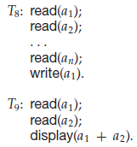
Lock Conversions
If, Two-phase locking
  Then T₈ must lock a₁ in exclusive mode, therefore, any concurrent execution of both transactions amounts to a serial execution
However, T₈ needs an exclusive lock on a₁ only at the end of its execution, when it writes a₁
  Thus, if T₈ could initially lock a₁ in shared mode, and then could later change the lock to exclusive mode, we could get more concurrency, since T₈ and T₉ could access a₁ and a₂ simultaneously
Solution
  A refinement of the basic two-phase locking protocol
    Lock conversions

Slide 28
Lock Conversions
A mechanism for upgrading a shared lock to an exclusive lock, and downgrading an exclusive lock to a shared lock
Conversion
  From shared to exclusive modes by upgrade, and
  From exclusive to shared by downgrade
Lock conversion cannot be allowed arbitrarily, Rather
  Upgrading can take place in only the growing phase
  Downgrading can take place in only the shrinking phase

Slide 29
Lock Conversions
Two-phase locking with lock conversions:
– First Phase:
  Can acquire a lock-S on item
  Can acquire a lock-X on item
  Can convert a lock-S to a lock-X (upgrade)
– Second Phase:
  Can release a lock-S
  Can release a lock-X
  Can convert a lock-X to a lock-S (downgrade)
This protocol assures serializability
But still relies on the programmer to insert the various locking instructions

Slide 30
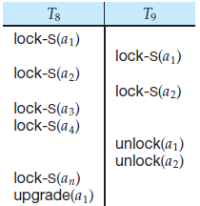
Lock Conversions
TransacitonsT₈ and T₉ can run concurrently under the refined two-phase locking protocol (here shown only some of the locking instructions)
  A transaction attempting to upgrade a lock on an item Q may be forced to wait
    Enforced wait occurs if Q is currently locked by another transaction in shared mode (T₈ last line in schedule)
Incomplete Schedule with lock conversion

Slide 31
Lock Conversions
Like the two-phase locking protocol, two-phase locking with lock conversion generates
  Only conflict-serializable schedules
    Transactions can be serialized by their lock points
If exclusive locks are held until the end of the transaction
  Then, the schedules are cascadeless

Slide 32
Automatic Acquisition of Locks
A transaction T_{i} issues the standard read/write instruction, without explicit locking calls
The operation read(D) is processed as:
if T_{i} has a lock on D
then
read(D)
else begin
if necessary wait until no other transaction has a lock-X on D
grant T_{i} a lock-S on D;
read(D)
end

Slide 33
Automatic Acquisition of Locks (Cont.)
The operation write(D) is processed as:
if T_{i} has a lock-X on D
then
write(D)
else begin
if necessary wait until no other trans. has any lock on D,
if T_{i} has a lock-S on D
then
upgrade lock on D to lock-X
else
grant T_{i} a lock-X on D
write(D)
end;
All locks are released after commit or abort

Slide 34
Implementation of Locking
Lock manager can be implemented as a separate process to which transactions send lock and unlock requests
  It replies, to a lock request by sending
    A lock grant messages
    A message asking the transaction to roll back (in case of a deadlock)
  The requesting transaction waits until its request is answered
  It maintains a data-structure called a lock table to record granted locks and pending requests

Slide 35
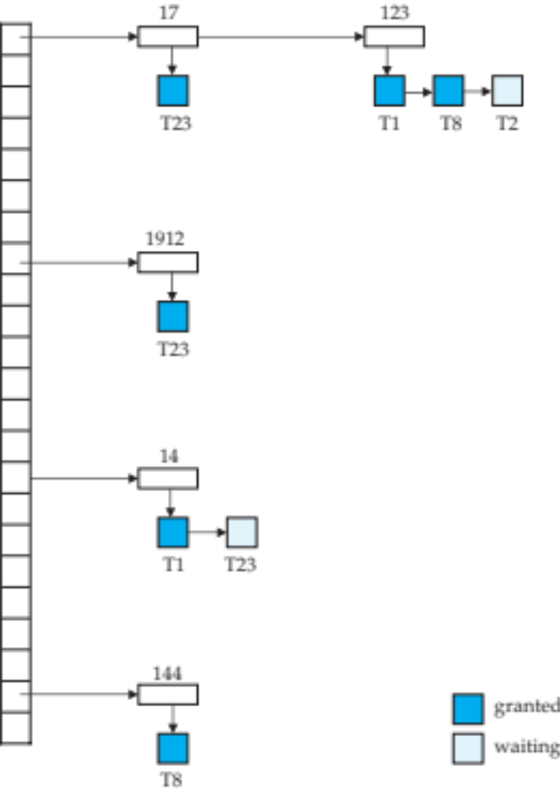
Lock Table
    Implemented as an in-memory hash table indexed on the name of the data item being locked
      Data item maintains link list of transaction record, one for each request, in the order in which the requests arrived
It also records the type of lock granted or requested (here not shown)
Data Items
  17, 1912, 14, 144 and 123
Colored rectangles
  Dark indicate granted locks
  Light indicate waiting requests

Slide 36
Lock Table
Example: Transaction T23 has been
  Granted locks on items 1912 and 17
  Waiting for a lock on item 14
When lock request arrives
  Step 1. if link list is present
    Adds a record to the end of the link list queue of requests for the data item,
    OR creates a new link list
  Step 2. Either Grants,
    If not currently locked, or If it is compatible with all earlier locks and ALL EARLIER REQUESTS HAVE BEEN GRANTED
    OR Waits

Slide 37
Lock Table
When unlock request arrives
  Step 1. Deletes the record for that data item in the linked list corresponding to that transaction
  Step 2. Also it checks, following requests are checked to see if they can now be granted. If it can, grants the request and process the record following it and so on
If transaction aborts
  Deletes all waiting or granted requests of the transaction
  Lock manager may keep a list of locks held by each transaction, to implement this efficiently (that helps in Recovery Ch. 16))

Slide 38
Lock Table
Advantages
  Freedom from starvation for lock requests
    As request can never be granted while a request received earlier is waiting to be granted
  Deadlock can occur
    But, Deadlock can be resolved (later section)

Slide 39
Graph-Based Protocols
An alternative to two-phase locking
Based on PRIOR KNOWLEDGE
  About the order in which the database items will be accessed
Impose a partial ordering → on the set D = {d₁, d₂ ,..., d_{h}} of all data items
  If d_{i} → d_{j} then any transaction accessing both d_{i} and d_{j} must access d_{i} before accessing d_{j}
  Implies that the set D may now be viewed as a directed acyclic graph, called a database graph
    Considering Graphs as Rooted Trees
A simple kind of graph protocol
  The tree-protocol
    Considering only exclusive locks (lock-x)

Slide 40

Tree Protocol
Transaction T_{i} can lock a data item by following rules:
The FIRST lock by T_{i} may be on ANY data item
Subsequently, a data item Q can be locked by T_{i} only if the parent of Q is currently locked by T_{i}
Data items may be unlocked at any time
A data item that has been locked and unlocked by T_{i} cannot subsequently be relocked by T_{i}

Slide 41
Tree Protocol
Four Transactions
  T₁₀ : lock-x(B), lock-x(E), lock-x(D), unlock(B), unlock(E), lock-x(G), unlock(D), unlock (G)
  T₁₁ : lock-x(D), lock-x(H), unlock(D), unlock (H)
  T₁₂ : lock-x(B), lock-x(E), unlock(E), unlock(B)
  T₁₃ : lock-x(D), lock-x(H), unlock(D), unlock (H)

Slide 42
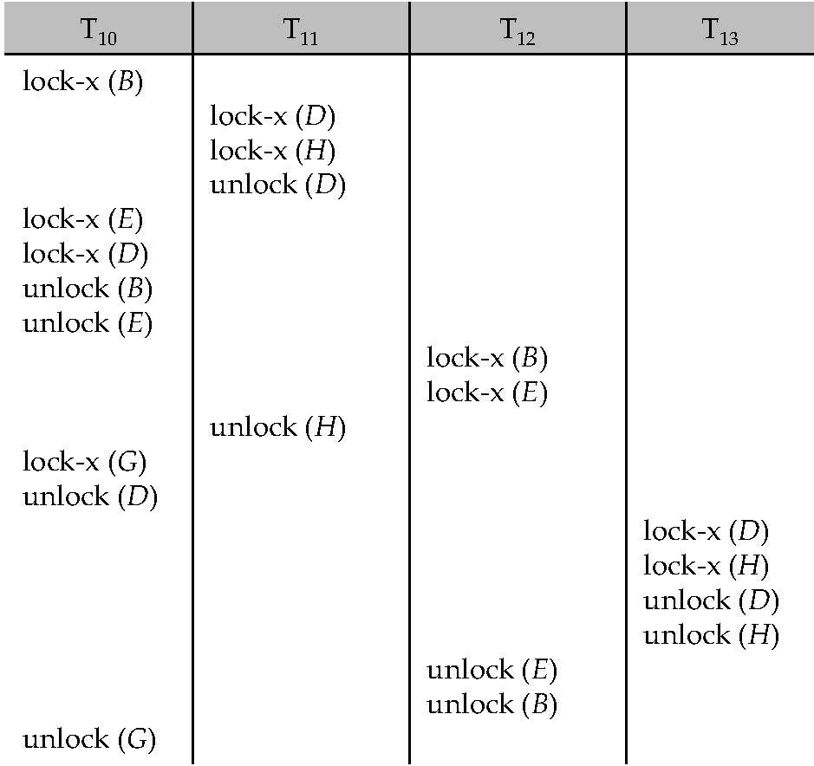
Tree Protocol
Serialized Schedule
Transaction T₁₀ holds locks on two disjoint subtrees

Slide 43
Graph-Based Protocols (Cont.)
Tree Protocol
      Ensures conflict serializability
      Advantages over two-phase locking
  Free from deadlock, so no rollbacks are required
  Unlocking may occur earlier
    Leads to shorter waiting times
    Increases concurrency

Slide 44
Graph-Based Protocols (Cont.)
Tree Protocol Drawbacks
  Transactions may have to lock data items that they do not access
    Increased locking overhead, and additional waiting time
    Potential decrease in concurrency
  Protocol does not guarantee recoverable or cascadelessness schedules
    To achieve this, protocol can be modified by not permitting x-lock until the end of transaction
      But, that reduces concurrency
    To achieve recoverability, need to introduce commit dependencies

Slide 45
Graph-Based Protocols (Cont.)
Commit dependencies
  For each data item with an uncommitted write, record which transaction performed the last write to the data item
  When transaction T_{i} reads uncommitted data, record the commit dependency of T_{i} transaction that performed the last write to the data item
  Transaction T_{i} is not permitted to commit until the commit of all transactions on which it has a commit dependency
  If any of these transactions aborts, T_{i} must also be aborted

Slide 46

Deadlock Handling
Consider the following two transactions:
T₁: write (X) T₂: write(Y)
write(Y) write(X)
Schedule with deadlock
System is deadlocked if there is a set of transactions such that every transaction in the set is waiting for another transaction in the set

Slide 47
Deadlock Handling Methods
1. Deadlock Prevention
  Ensures that the system will never enter into a deadlock state
2. Deadlock Detection and Recovery
  Allow the system to enter a deadlock state and then try to recover
Utilize, If the probability that the system would enter a deadlock state,
  Relatively high
    Deadlock Prevention
  Low
    Deadlock Detection and Recovery

Slide 48
Deadlock Prevention
Deadlock Prevention Schemes based on
  The ordering of lock requests or all locks to be acquired together
  Using transaction rollback instead of waiting for a lock

Slide 49
Deadlock Prevention
A. Deadlock Prevention Schemes based on ordering and all locks together
  Impose partial ordering of all data items and require that a transaction can lock data items only in the order specified by the partial order (graph-based protocol)
    Disadvantages
      Transactions may have to lock data items that they do not access and thus increased locking overhead, additional waiting time and decrease in concurrency
      Protocol does not guarantee recoverable or cascadelessness schedules

Slide 50
Deadlock Prevention
Deadlock Prevention Schemes based on ordering and all locks together
  Require that each transaction locks all its data items before it begins execution (predeclaration)
    Disadvantages
      Before the transaction begins, it is hard to predict, what data items need to be locked
      Data item utilization may be very low, as many of data items may be locked but unused for a long time

Slide 51
Deadlock Prevention
B. Deadlock Prevention Schemes using Rollbacks
  Uses the concept of Preemption
    When a transaction Tx requests a lock that transaction Ti holds, the lock granted to Ti may be preempted by rolling back of Ti and granting of the lock to Tx
    To decide whether to roll back or wait, assigns transaction timestamp based on a
        Counter
        Time stamp is the value of the counter when the transaction enters the system
        Incremented after a new timestamp has been assigned
        System clock
        Value of the clock when the transaction enters the system

Slide 52
Deadlock Prevention
B. Deadlock Prevention Schemes using Rollbacks
    If the transaction is rollback, it retains the old timestamp when restarted
    Schemes
      wait-die and wound-wait

Slide 53
More Deadlock Prevention Strategies
Transaction timestamp based schemes for the deadlock prevention
  wait-die scheme — non-preemptive
    Allows the older transaction to wait but kills the younger one
    If TS(T_{i}) < TS(T_{j}) : T_{i} is older than T_{j} − then, T_{i} is allowed to wait
        Older transaction may wait for younger one to release data item
    If TS(T_{i}) > TS(t_{j}) : T_{i} is younger than T_{j} − then T_{i} dies and T_{i} is restarted later with a random delay but with the same timestamp
        Younger transactions never wait for older ones; they are rolled back instead
    Transaction may die several times before acquiring needed data item

Slide 54
More Deadlock Prevention Strategies
Transaction timestamp based schemes for the deadlock prevention
  wait-die scheme — non-preemptive
    Example
    Transaction T₂₂, T₂₃, T₂₄ have time-stamps 5, 10 and 15 respectively
      (5 is older timestamp, 15 younger timestamp)
      If T₂₂ requests a data item held by T₂₃ then T₂₂ will wait
      If T₂₄ requests a data item held by T₂₃, then T₂₄ will be rolled back

Slide 55
More Deadlock Prevention Strategies
Transaction timestamp based schemes for the deadlock prevention
  wound-wait scheme — preemptive
    Older transaction wounds (forces to abort or release the item by rollback ) of younger transaction instead of waiting for it
    If TS(T_{i}) < TS(T_{j}), then
      T_{i} forces T_{j} to be rolled back − that is T_{i} wounds T_{j}
      T_{j} is restarted later with a random delay but with the same timestamp
    Younger transactions may wait for older ones
    If TS(T_{i}) > TS(T_{j}), then T_{i} is forced to wait until the data item is available

Slide 56
More Deadlock Prevention Strategies
Transaction timestamp based schemes for the deadlock prevention
  wound-wait scheme — preemptive
    Example
    Transactions T₂₂, T_{23,} T₂₄ have time-stamps 5, 10 and 15 respectively
      If T₂₂ requests a data item held by T₂₃, then data item will be preempted from T₂₃ and T₂₃ will be rolled back
      If T₂₄ requests a data item held by T₂₃, then T₂₄ will wait

Slide 57
Deadlock Prevention (Cont.)
Time-stamp based Schemes
  Wait-Die „
    Wait: If Ti is older than Tj, then Ti waits
    Die: If Ti is younger than Tj, then abort Ti
  Wound-Wait „
    Wound: If Ti is older than Tj, then abort Tj
    Wait: If Ti is younger than Tj, then Ti waits
  Rolled back transactions are restarted with its original timestamp
  Older transactions thus have precedence over newer ones, and starvation is hence avoided

Slide 58
Deadlock Prevention (Cont.)
Timeout-Based Schemes
  A transaction waits for a lock only for a specified amount of time After that, the wait times out and the transaction is rolled back
    Thus deadlocks are not possible
  Simple to implement; but starvation is possible
  Also difficult to determine good value of the timeout interval

Slide 59
Deadlock Detection & Recovery
Aborting a transaction is not always a practical approach
Instead, deadlock avoidance mechanisms can be used to detect any deadlock situation in advance
  Method "wait-for graph“
    Suitable for only those systems where transactions are lightweight having fewer instances of resource
    In a bulky system, deadlock prevention techniques may work well

Slide 60
Deadlock Detection
wait-for graph
  Consists of a pair G = (V,E),
    V is a set of vertices (all the transactions in the system)
    E is a set of edges; each element is an ordered pair T_{i} →T_{j}
  If T_{i} → T_{j} is in E, Directed edge from T_{i} to T_{j},
    Implying that T_{i} is waiting for T_{j} to release a data item
  When T_{i} requests a data item currently being held by T_{j}, then the edge T_{i} T_{j} is inserted in the wait-for graph
    This edge is removed only when T_{j} is no longer holding a data item needed by T_{i}
  The system is in a deadlock state if and only if the wait-for graph has a cycle
    Must invoke a deadlock-detection algorithm periodically to look for cycles

Slide 61


Deadlock Detection (Cont.)
Waits for z
Waits for z
Waits for x
Waits for x
Waits for x
Waits for x
Waits for y
Waits for y
Waits for y
Wait-for graph without a cycle
T₁₇ waiting for T₁₈ and T₁₉
T₁₉ waiting for T₁₈
T₁₈waiting for T₂₀
Wait-for graph with a cycle
One more, T₂₀ waiting for T₁₉
T₁₈,T₁₉ and T₂₀ are deadlocked

Slide 62
Deadlock Recovery
When deadlock is detected, actions : For the rollback
  Selection of a victim -- determine which transaction (made a victim) to rollback to break deadlock with minimum cost factors
      How long the transaction has computed, and how much longer the transaction will compute before it completes
      How many data items used by the transaction
      How many more data items needs for the completion
      How many transactions will be involved in rollback

Slide 63
Deadlock Recovery
When deadlock is detected, actions : For the rollback
  1. Selection of a victim
  2. Rollback -- determine how far to roll back transaction
    Total rollback: Abort the transaction and then restart it
    Partial rollback: More effective to roll back transaction only as far as necessary to break deadlock requires to manage extra information
  3. Starvation -- if same transaction is always chosen as victim, not allowing it to complete
    Pick victim only for finite number of times and use number of rollbacks as cost factor

Slide 64
Multiple Granularity
Till this, used individual data items as the synchronization unit
Advantageous, if consider groups of several data items and treat them as one individual synchronization unit
  If locks of all items of database is needed
    Time consuming, if locking each item individually in the database
    Better, if using a single lock for the entire database
  If locks of only few data item is needed
    Not to lock entire database, otherwise concurrency will lost

Slide 65
Multiple Granularity
Allow data items to be of various sizes and define a hierarchy of data granularities, where the small granularities are nested within larger ones
Can be represented graphically as a tree (but don't confuse with tree-locking protocol)
When a transaction locks a node in the tree explicitly, it implicitly locks all the node's descendents in the same mode

Slide 66

Multiple Granularity
If transaction Ti gets an explicit lock on file Fc in X-mode
  Then, it has an implicit lock in X-mode on all the records belonging to that file
  Does not require to lock the individual records of Fc explicitly

Slide 67
Multiple Granularity
If Transaction Tj wishes to lock record rb6 of file Fb, since Ti has locked Fb explicitly, it follows that rb6 is also locked (implicitly)
  Whether to lock or not, Tj must traverse the tree from the root to record rb6. if any node in that path is locked in an incompatible mode, then Tj must be delayed

Slide 68
Multiple Granularity
Granularity of locking (level in tree where locking is done)
  Fine granularity (lower in tree)
    High concurrency
    High locking overhead
  Coarse granularity (higher in tree)
    Low locking overhead
    Low concurrency
The levels, starting from the coarsest (top) level are
Database, Area , File, Record

Slide 69
Multiple Granularity
If Transaction Tk wishes to lock the entire database, it is simply must lock the root of the hierarchy
  But, Tk should not succeed in locking the root node, since Ti is currently holding a lock on part of the tree (e.g. if, Fb)
  But, how does the system determine, if the root node can be locked?
    Solution 1: Search the complete tree,
    Not feasible
    Solution 2:

Slide 70
Multiple Granularity
But, how does the system determine, if the root node can be locked?
  Solution 1: Search the complete tree, Not feasible
  Solution 2: Introduced New class of lock – INTENSION lock modes
    If a node is locked in an intention mode, explicit locking is done at a lower level of the tree
    Intention locks are put on all the ancestors of a node before that node is locked explicitly
    So, the transaction does not need to search the entire tree to determine whether it can lock

Slide 71
Intention Lock Modes
In addition to S and X lock modes, there are three additional lock modes with multiple granularity:
  intention-shared (IS): Indicates explicit locking at a lower level of the tree but only with shared locks
  intention-exclusive (IX): Indicates explicit locking at a lower level with exclusive or shared locks
  shared and intention-exclusive (SIX): The subtree rooted by that node is locked explicitly in shared mode and explicit locking is being done at a lower level with exclusive-mode locks
Intention locks allow a higher level node to be locked in S or X mode without having to check all descendent nodes

Slide 72

Compatibility Matrix with Intention Lock Modes
The compatibility matrix for all lock modes is:

Slide 73
Multiple Granularity Locking Scheme
Transaction T_{i} can lock a node Q, using the following rules:
  The lock compatibility matrix must be observed.
  The root of the tree must be locked first, and may be locked in any mode.
  A node Q can be locked by T_{i} in S or IS mode only if the parent of Q is currently locked by T_{i} in either IX or IS mode.
  A node Q can be locked by T_{i} in X, SIX, or IX mode only if the parent of Q is currently locked by T_{i} in either IX or SIX mode.
  T_{i} can lock a node only if it has not previously unlocked any node (that is, T_{i} is two-phase).
  T_{i} can unlock a node Q only if none of the children of Q are currently locked by T_{i}.
Observe that locks are acquired in root-to-leaf order, whereas they are released in leaf-to-root order.
Lock granularity escalation: in case there are too many locks at a particular level, switch to higher granularity S or X lock

Slide 74
Intention Lock Modes
If Transaction T21 reads a record ra2 in file Fa,
  Then T21 needs to lock the database area A1 and Fa in IS mode and finally to lock ra2 in S mode
If Transaction T22 modifies a record ra9 in file Fa,
  Then T22 needs to lock the database area A1 and Fa in IX mode and finally to lock ra9 in X mode
Concurrently allowed: T21 and T22

Slide 75
Intention Lock Modes
If Transaction T21 reads a record ra2 in file Fa,
  Then T21 needs to lock the database area A1 and Fa in IS mode and finally to lock ra2 in S mode
If Transaction T22 modifies record ra9 in file Fa
  Then, T22 needs to lock the database, area A1, and file Fa (and in that order) in IX mode, and finally to lock ra9 in X mode
If Transaction T23 reads all the records in file Fa,
  Then T23 needs to lock the database area A1 in IS mode and and finally to lock Fa in S mode
If Transaction T24 reads the entire database,
  Then T24 needs lock on the database S mode
T21, T23, and T24 can access the database concurrently
Transaction T22 can execute concurrently with T21,
but not T22 with either T23 or T24.

Slide 76
Intention Lock Modes
Enhances concurrency and reduces lock overhead
Useful in applications, that include a mix of
  Short transactions that access only a few data items
  Long transactions that produce reports from an entire file or set of files

Slide 77
View Serializability

Slide 78
Serializability
View-serializability of a schedule is defined by equivalence to a serial schedule (no overlapping transactions) with the same transactions, such that respective transactions in the two schedules read and write the same data values ("view" the same data values)
Conflict-serializability is defined by equivalence to a serial schedule (no overlapping transactions) with the same transactions, such that both schedules have the same sets of respective chronologically ordered pairs of conflicting operations (same precedence relations of respective conflicting operations)

Slide 79
Check for Conflict Serializability
T1 | T2
R(A)
W(A)
 | R(A)
R(B)
 | W(A)
W(B)
 | R(B)
 | W(B)
YES, Conflict Serializable
Serial Schedule: <T1, T2>

Slide 80
View Serializability
Let S1 and S2 be two schedules with the same set of transactions. S1 and S2 are view equivalent if the following three conditions are met, for each data item A,
  Schedules S1 and S2 are view equivalent, If Ti reads initial value of A in S1, then Ti also reads initial value of A in S2
  If Ti reads value of A written by Tj in S1, then Ti also reads value of A written by Tj in S2
  If Ti writes final value of A in S1, then Ti also writes final value of A in S2

Slide 81
View Serializability (Cont.)
Example: Check View Serializabiltiy: W3(Z), R2(X), W2(Y), R1(Z), W3(Y), W1(Y)
  To check for view serializability of a schedule, you must create all possible combinations of the Transactions
  Here three transactions, then you need to check for these combinations:
  < T1, T2, T3 >
  < T1, T3, T2 >
  < T2, T1, T3 >
  < T2, T3, T1 >
  < T3, T1, T2 >
  < T3, T2, T1 >
Now the schedule is view serializable if:
  A Tx reads an initial data in a Schedule, the same Tx also should read the initial data in one of the transaction combination.
    Here, at least T2 must occur first
    Though it actually doesn’t matter also because no one else writes X, so we still keep all our Tx combinations

Slide 82
View Serializability (Cont.)
Example: W3(Z), R2(X), W2(Y), R1(Z), W3(Y), W1(Y)
  A Tx reads a data after another Tx has written in a Schedule, the same Tx also should read the data after another Tx has written it in one of the transaction combination.
    Now, this means that T1 must occur after T3 because T1 reads Z after T3 writes it. So we remove all where T1 is before T3
      < T1, T2, T3 >
      < T1, T3, T2 >
      < T2, T1, T3 >
< T1, T2, T3 >
< T1, T3, T2 >
< T2, T1, T3 >
< T2, T3, T1 >
< T3, T1, T2 >
< T3, T2, T1 >
< T2, T3, T1 >
< T3, T1, T2 >
< T3, T2, T1 >

Slide 83
View Serializability (Cont.)
Example: W3(Z), R2(X), W2(Y), R1(Z), W3(Y), W1(Y)
  A Tx writes the final value for a data in a Schedule, the same Tx should also write the final data in one of the transaction combination.
    Here, T1 must occur last after T3 or T2 because if not T3 or T2 will overwrites Y that T1 writes in our schedule. So we remove < T3, T1, T2 >
So two combinations left satisfy the view serializability, they are:
< T2, T3, T1 >
< T3, T2, T1 >
< T2, T3, T1 >
< T3, T1, T2 >
< T3, T2, T1 >
< T2, T3, T1 >
< T3, T2, T1 >

Slide 84
View Serializability (Cont.)
Example: R1(X),R2(Y),R2(Y),W2(X),W3(Y),R1(X)
  A Tx reads an initial data in a Schedule, the same Tx also should read the initial data in one of the transaction combination.
    Here, at least T1 must occur first, before T2, so we remove
    <T2, T1, T3>
    <T2, T3, T1>
    <T3, T2, T1>
< T1, T2, T3 >
< T1, T3, T2 >
< T2, T1, T3 >
< T2, T3, T1 >
< T3, T1, T2 >
< T3, T2, T1 >
< T1, T2, T3 >
< T1, T3, T2 >
< T3, T1, T2 >

Slide 85
View Serializability (Cont.)
Example: R1(X),R2(Y),R2(Y),W2(X),W3(Y),R1(X)
  A Tx reads a data after another Tx has written in a Schedule, the same Tx also should read the data after another Tx has written it in one of the transaction combination
    T1 reads X after T2 writes, means that T2 should occur before T1
        But wait a minute, we’ve just said that T1 should occur before T2 on the previous condition
        Because a cycle in the graph also caused
        Need T1 before T2 and at the same time, need T2 before T1
        Because of this, none of the combinations can satisfy these two conditions, so it is not view serializable.

Slide 86

View Serializability (Cont.)
Example:
Conflict Serializable?
Conflict is NOT resolved, so it is NOT Conflict Serializable
View Serializable?
  <T2, T1,T3>
YES, view serializable schedule and schedule T2,T1,T3 is view equivalent schedule for the given schedule
A
A,B
T1
T2
T3
B

Slide 87
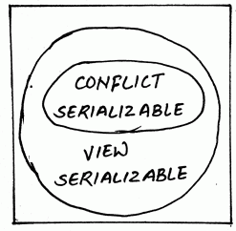
Conflict serializable vs View Serializable
Difference Between Conflict Equivalent Schedule and View Equivalent Schedule
  Conflict serializability is easy to achieve but view serializability is difficult to achieve
  Every conflict serializable is view serializable but the reverse is not true
  It is easy to test conflict serializability but expensive to test view serializability
  Most of the concurrency control schemes used in practice are based on conflict serializability

Slide 88
Insert and Delete Operations
If two-phase locking is used :
  A delete operation may be performed only if the transaction deleting the tuple has an exclusive lock on the tuple to be deleted
  A transaction that inserts a new tuple into the database is given an X-mode lock on the tuple

Slide 89
Insert and Delete Operations
Insertions and deletions can lead to the phantom phenomenon
  A transaction that scans a relation
    e.g., find sum of balances of all accounts in Perryridge
    and a transaction that inserts a tuple in the relation
    e.g., insert a new account at Perryridge
    (conceptually) conflict in spite of not accessing any tuple in common
  If only tuple locks are used, non-serializable schedules can result
    e.g. the scan transaction does not see the new account, but reads some other tuple written by the update transaction

Slide 90
Insert and Delete Operations (Cont.)
The transaction scanning the relation is reading information that indicates what tuples the relation contains, while a transaction inserting a tuple updates the same information
  The conflict should be detected, e.g. by locking the information
One solution
  Associate a data item with the relation, to represent the information about what tuples the relation contains
  Transactions scanning the relation acquire a shared lock in the data item,
  Transactions inserting or deleting a tuple acquire an exclusive lock on the data item (Note: locks on the data item do not conflict with locks on individual tuples)
Above protocol provides very low concurrency for insertions / deletions

Slide 91
Caution
Some statements cannot be rolled back
  Data definition language (DDL) statements, such as
    Create or drop databases, create, drop, or alter tables or stored routines
Design your transactions not to include such statements
If you issue a statement early in a transaction that cannot be rolled back, and then another statement later fails, the full effect of the transaction cannot be rolled back in such cases by issuing a ROLLBACK statement

Slide 92
Implicit Commit
Statements That Cause an Implicit Commit
Implicitly end any transaction active in the current session, as if you had done a COMMIT before executing the statement
Intent is to handle each such statement in its own special transaction because it cannot be rolled back anyway
Transaction-control and locking statements are exceptions: If an implicit commit occurs before execution, another does not occur after
Data definition language (DDL) statements that define or modify database objects
  ALTER DATABASE , CREATE DATABASE, CREATE INDEX, CREATE PROCEDURE, CREATE TABLE, CREATE TRIGGER, CREATE VIEW, DROP DATABASE, DROP PROCEDURE, DROP TABLE, DROP TRIGGER, DROP VIEW, TRUNCATE TABLE

Slide 93
Weak Levels of Consistency
Four levels of transaction isolation with differing degrees of impact on transaction processing throughput
These isolation levels are defined in terms of three phenomena that must be prevented between concurrently executing transactions
The three preventable phenomena are:
  Dirty reads: A transaction reads data that has been written by another transaction that has not been committed yet
  Nonrepeatable (fuzzy) reads: A transaction rereads data it has previously read and finds that another committed transaction has modified or deleted the data
  Phantom reads (or phantoms): A transaction re-runs a query returning a set of rows that satisfies a search condition and finds that another committed transaction has inserted additional rows that satisfy the condition

Slide 94
Isolation Level
Read committed
  This is the default transaction isolation level
  Each query executed by a transaction sees only data that was committed before the query (not the transaction) began
  Never reads dirty (uncommitted) data
    Not preventing other transactions from modifying the data read by a query, that data can be changed by other transactions between two executions of the query
    Thus, a transaction that runs a given query twice can experience both nonrepeatable read and phantoms

Slide 95
Isolation Level
Serializable
  Transactions see only those changes that were
    Committed at the time the transaction began, plus
    Those changes made by the transaction itself through INSERT, UPDATE, and DELETE statements
  Serializable transactions do not experience nonrepeatable reads or phantoms

Slide 96
Weak Levels of Consistency
Preventable Read Phenomena by Isolation Level
Isolation Level | Dirty Read | Nonrepeatable Read | Phantom Read
Read uncommitted | Possible | Possible | Possible
Read committed | Not possible | Possible | Possible
Repeatable read | Not possible | Not possible | Possible
Serializable | Not possible | Not possible | Not possible

Slide 97
Timestamp-Based Protocols
Each transaction is issued a timestamp when it enters the system
If an old transaction T_{i} has time-stamp TS(T_{i}), a new transaction T_{j} is assigned time-stamp TS(T_{j}) such that TS(T_{i}) <TS(T_{j})
The protocol manages concurrent execution such that the time-stamps determine the serializability order
In order to assure such behavior, the protocol maintains for each data Q two timestamp values:
  W-timestamp(Q) is the largest time-stamp of any transaction that executed write(Q) successfully
  R-timestamp(Q) is the largest time-stamp of any transaction that executed read(Q) successfully

Slide 98
Timestamp-Based Protocols (Cont.)
The timestamp ordering protocol ensures that any conflicting read and write operations are executed in timestamp order
Suppose a transaction T_{i} issues a read(Q)
  If TS(T_{i}) ≤ W-timestamp(Q), then T_{i} needs to read a value of Q that was already overwritten
    Hence, the read operation is rejected, and T_{i} is rolled back
  If TS(T_{i})≥ W-timestamp(Q), then the read operation is executed, and R-timestamp(Q) is set to max(R-timestamp(Q), TS(T_{i}))

Slide 99
Timestamp-Based Protocols (Cont.)
Suppose that transaction T_{i} issues write(Q).
  If TS(T_{i}) < R-timestamp(Q), then the value of Q that T_{i} is producing was needed previously, and the system assumed that that value would never be produced.
    Hence, the write operation is rejected, and T_{i} is rolled back.
  If TS(T_{i}) < W-timestamp(Q), then T_{i} is attempting to write an obsolete value of Q.
    Hence, this write operation is rejected, and T_{i} is rolled back.
  Otherwise, the write operation is executed, and W-timestamp(Q) is set to TS(T_{i}).

Slide 100

Example Use of the Protocol
A partial schedule for several data items for transactions with
timestamps 1, 2, 3, 4, 5

Slide 101
Snapshot Isolation
Motivation: Decision support queries that read large amounts of data have concurrency conflicts with OLTP transactions that update a few rows
  Poor performance results
Solution 1: Give logical “snapshot” of database state to read only transactions, read-write transactions use normal locking
  Multiversion 2-phase locking
  Works well, but how does system know a transaction is read only?
Solution 2: Give snapshot of database state to every transaction, updates alone use 2-phase locking to guard against concurrent updates
  Problem: variety of anomalies such as lost update can result
  Partial solution: snapshot isolation level (next slide)
    Proposed by Berenson et al, SIGMOD 1995
    Variants implemented in many database systems
      E.g. Oracle, PostgreSQL, SQL Server 2005

Slide 102
Snapshot Isolation
A transaction T1 executing with Snapshot Isolation
  takes snapshot of committed data at start
  always reads/modifies data in its own snapshot
  updates of concurrent transactions are not visible to T1
  writes of T1 complete when it commits
  First-committer-wins rule:
    Commits only if no other concurrent transaction has already written data that T1 intends to write.
T1 | T2 | T3
W(Y := 1) Commit
 | Start R(X) → 0 R(Y)→ 1
 |  | W(X:=2) W(Z:=3) Commit
 | R(Z) → 0 R(Y) → 1 W(X:=3) Commit-Req Abort
Concurrent updates not visible
Own updates are visible
Not first-committer of X
Serialization error, T2 is rolled back

Slide 103

Snapshot Read
Concurrent updates invisible to snapshot read

Slide 104

Snapshot Write: First Committer Wins
  Variant: “First-updater-wins”
    Check for concurrent updates when write occurs by locking item
      But lock should be held till all concurrent transactions have finished
    (Oracle uses this plus some extra features)
    Differs only in when abort occurs, otherwise equivalent

Slide 105
Benefits of SI
Reading is never blocked,
  and also doesn’t block other txns activities
Performance similar to Read Committed
Avoids the usual anomalies
  No dirty read
  No lost update
  No non-repeatable read
  Predicate based selects are repeatable (no phantoms)
Problems with SI
  SI does not always give serializable executions
    Serializable: among two concurrent txns, one sees the effects of the other
    In SI: neither sees the effects of the other
  Result: Integrity constraints can be violated

Slide 106
Snapshot Isolation
E.g. of problem with SI
  T1: x:=y
  T2: y:= x
  Initially x = 3 and y = 17
    Serial execution: x = ??, y = ??
    if both transactions start at the same time, with snapshot isolation: x = ?? , y = ??
Called skew write
Skew also occurs with inserts
  E.g:
    Find max order number among all orders
    Create a new order with order number = previous max + 1

Slide 107
End

Slide 108

Correctness of Timestamp-Ordering Protocol
The timestamp-ordering protocol guarantees serializability since all the arcs in the precedence graph are of the form:
Thus, there will be no cycles in the precedence graph
Timestamp protocol ensures freedom from deadlock as no transaction ever waits.
But the schedule may not be cascade-free, and may not even be recoverable.

Slide 109
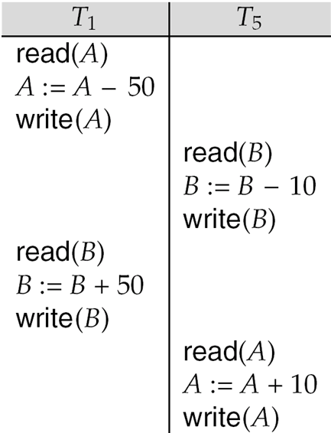
Other Notions of Serializability
The schedule below produces same outcome as the serial schedule < T₁, T₅ >, yet is not conflict equivalent or view equivalent to it.
Determining such equivalence requires analysis of operations other than read and write.
  Operation-conflicts, operation locks

Slide 110
Validation-Based Protocol
Execution of transaction T_{i} is done in three phases.
1. Read and execution phase: Transaction T_{i} writes only to
temporary local variables
2. Validation phase: Transaction T_{i} performs a “validation test''
to determine if local variables can be written without violating
serializability.
3. Write phase: If T_{i} is validated, the updates are applied to the
database; otherwise, T_{i} is rolled back.
The three phases of concurrently executing transactions can be interleaved, but each transaction must go through the three phases in that order.
  Assume for simplicity that the validation and write phase occur together, atomically and serially
    I.e., only one transaction executes validation/write at a time.
Also called as optimistic concurrency control since transaction executes fully in the hope that all will go well during validation

Slide 111
Validation-Based Protocol (Cont.)
Each transaction T_{i} has 3 timestamps
  Start(T_{i}) : the time when T_{i} started its execution
  Validation(T_{i}): the time when T_{i} entered its validation phase
  Finish(T_{i}) : the time when T_{i} finished its write phase
Serializability order is determined by timestamp given at validation time, to increase concurrency.
  Thus TS(T_{i}) is given the value of Validation(T_{i}).
This protocol is useful and gives greater degree of concurrency if probability of conflicts is low.
  because the serializability order is not pre-decided, and
  relatively few transactions will have to be rolled back.

Slide 112
Validation Test for Transaction T_{j}
If for all T_{i} with TS (T_{i}) < TS (T_{j}) either one of the following condition holds:
  finish(T_{i}) < start(T_{j})
  start(T_{j}) < finish(T_{i}) < validation(T_{j}) and the set of data items written by T_{i} does not intersect with the set of data items read by T_{j}.
then validation succeeds and T_{j} can be committed. Otherwise, validation fails and T_{j} is aborted.
Justification: Either the first condition is satisfied, and there is no overlapped execution, or the second condition is satisfied and
  the writes of T_{j} do not affect reads of T_{i} since they occur after T_{i} has finished its reads.
  the writes of T_{i} do not affect reads of T_{j} since T_{j} does not read any item written by T_{i}.

Slide 113

Schedule Produced by Validation
Example of schedule produced using validation

Slide 114
Time-stamp Ordering Protocol
Recoverability and Cascade Freedom
Problem with timestamp-ordering protocol:
  Suppose T_{i} aborts, but T_{j} has read a data item written by T_{i}
  Then T_{j} must abort; if T_{j} had been allowed to commit earlier, the schedule is not recoverable.
  Further, any transaction that has read a data item written by T_{j} must abort
  This can lead to cascading rollback --- that is, a chain of rollbacks
Solution 1:
  A transaction is structured such that its writes are all performed at the end of its processing
  All writes of a transaction form an atomic action; no transaction may execute while a transaction is being written
  A transaction that aborts is restarted with a new timestamp
Solution 2: Limited form of locking: wait for data to be committed before reading it
Solution 3: Use commit dependencies to ensure recoverability

Slide 115
Thomas’ Write Rule
Modified version of the timestamp-ordering protocol in which obsolete write operations may be ignored under certain circumstances.
When T_{i} attempts to write data item Q, if TS(T_{i}) < W-timestamp(Q), then T_{i} is attempting to write an obsolete value of {Q}.
  Rather than rolling back T_{i} as the timestamp ordering protocol would have done, this {write} operation can be ignored.
Otherwise this protocol is the same as the timestamp ordering protocol.
Thomas' Write Rule allows greater potential concurrency.
  Allows some view-serializable schedules that are not conflict-serializable.

Slide 116
Index Locking Protocol
Provides higher concurrency while preventing the phantom phenomenon, by requiring locks on certain index buckets
  Every relation must have at least one index
  A transaction can access tuples only after finding them through one or more indices on the relation
  A transaction T_{i} that performs a lookup must lock all the index leaf nodes that it accesses, in S-mode
    Even if the leaf node does not contain any tuple satisfying the index lookup (e.g. for a range query, no tuple in a leaf is in the range)
  Transaction T_{i} that inserts, updates or deletes a tuple t_{i} in a relation r
    Must update all indices to r
    Must obtain X-locks on all index leaf nodes affected by the insert/update/delete
  The rules of the two-phase locking protocol must be observed
Guarantees that phantom phenomenon won’t occur

Slide 117
Next-Key Locking
Index-locking protocol to prevent phantoms required locking entire leaf
  Can result in poor concurrency if there are many inserts
Alternative: for an index lookup
  Lock all values that satisfy index lookup (match lookup value, or fall in lookup range)
  Also lock next key value in index
  Lock mode: S for lookups, X for insert/delete/update
Ensures that range queries will conflict with inserts/deletes/updates
  Regardless of which happens first, as long as both are concurrent

Slide 118
Concurrency in Index Structures
Indices are unlike other database items in that their only job is to help in accessing data
Index-structures are typically accessed very often, much more than other database items
  Treating index-structures like other database items, e.g. by 2-phase locking of index nodes can lead to low concurrency
There are several index concurrency protocols where locks on internal nodes are released early, and not in a two-phase fashion
  It is acceptable to have nonserializable concurrent access to an index as long as the accuracy of the index is maintained
    In particular, the exact values read in an internal node of a
    B⁺-tree are irrelevant so long as we land up in the correct leaf node

Slide 119
Concurrency in Index Structures (Cont.)
Example of index concurrency protocol:
Use crabbing instead of two-phase locking on the nodes of the B⁺-tree, as follows. During search/insertion/deletion:
  First lock the root node in shared mode.
  After locking all required children of a node in shared mode, release the lock on the node.
  During insertion/deletion, upgrade leaf node locks to exclusive mode.
  When splitting or coalescing requires changes to a parent, lock the parent in exclusive mode.
Above protocol can cause excessive deadlocks
  Searches coming down the tree deadlock with updates going up the tree
  Can abort and restart search, without affecting transaction
Better protocols are available; see Section 16.9 for one such protocol, the B-link tree protocol
  Intuition: release lock on parent before acquiring lock on child
    And deal with changes that may have happened between lock release and acquire

Slide 120
Multiversion Schemes
Multiversion schemes keep old versions of data item to increase concurrency.
  Multiversion Timestamp Ordering
  Multiversion Two-Phase Locking
Each successful write results in the creation of a new version of the data item written.
Use timestamps to label versions.
When a read(Q) operation is issued, select an appropriate version of Q based on the timestamp of the transaction, and return the value of the selected version.
reads never have to wait as an appropriate version is returned immediately.

Slide 121
Multiversion Timestamp Ordering
Each data item Q has a sequence of versions <Q₁, Q₂,...., Q_{m}>. Each version Q_{k} contains three data fields:
  Content -- the value of version Q_{k}.
  W-timestamp(Q_{k}) -- timestamp of the transaction that created (wrote) version Q_{k}
  R-timestamp(Q_{k}) -- largest timestamp of a transaction that successfully read version Q_{k}
when a transaction T_{i} creates a new version Q_{k} of Q, Q_{k}'s W-timestamp and R-timestamp are initialized to TS(T_{i}).
R-timestamp of Q_{k} is updated whenever a transaction T_{j} reads Q_{k}, and TS(T_{j}) > R-timestamp(Q_{k}).

Slide 122
Multiversion Timestamp Ordering (Cont)
Suppose that transaction T_{i} issues a read(Q) or write(Q) operation. Let Q_{k} denote the version of Q whose write timestamp is the largest write timestamp less than or equal to TS(T_{i}).
  If transaction T_{i} issues a read(Q), then the value returned is the content of version Q_{k}.
  If transaction T_{i} issues a write(Q)
    if TS(T_{i}) < R-timestamp(Q_{k}), then transaction T_{i} is rolled back.
    if TS(T_{i}) = W-timestamp(Q_{k}), the contents of Q_{k} are overwritten
    else a new version of Q is created.
Observe that
  Reads always succeed
  A write by T_{i} is rejected if some other transaction T_{j} that (in the serialization order defined by the timestamp values) should read
  T_{i}'s write, has already read a version created by a transaction older than T_{i}.
Protocol guarantees serializability

Slide 123
Multiversion Two-Phase Locking
Differentiates between read-only transactions and update transactions
Update transactions acquire read and write locks, and hold all locks up to the end of the transaction. That is, update transactions follow rigorous two-phase locking.
  Each successful write results in the creation of a new version of the data item written.
  each version of a data item has a single timestamp whose value is obtained from a counter ts-counter that is incremented during commit processing.
Read-only transactions are assigned a timestamp by reading the current value of ts-counter before they start execution; they follow the multiversion timestamp-ordering protocol for performing reads.

Slide 124
Multiversion Two-Phase Locking (Cont.)
When an update transaction wants to read a data item:
  it obtains a shared lock on it, and reads the latest version.
When it wants to write an item
  it obtains X lock on; it then creates a new version of the item and sets this version's timestamp to ∞.
When update transaction T_{i} completes, commit processing occurs:
  T_{i} sets timestamp on the versions it has created to ts-counter + 1
  T_{i} increments ts-counter by 1
Read-only transactions that start after T_{i} increments ts-counter will see the values updated by T_{i}.
Read-only transactions that start before T_{i} increments the
ts-counter will see the value before the updates by T_{i}.
Only serializable schedules are produced.

Slide 125
MVCC: Implementation Issues
Creation of multiple versions increases storage overhead
  Extra tuples
  Extra space in each tuple for storing version information
Versions can, however, be garbage collected
  E.g. if Q has two versions Q5 and Q9, and the oldest active transaction has timestamp > 9, than Q5 will never be required again

Slide 126
Snapshot Isolation Anomalies
SI breaks serializability when txns modify different items, each based on a previous state of the item the other modified
  Not very common in practice
    E.g., the TPC-C benchmark runs correctly under SI
    when txns conflict due to modifying different data, there is usually also a shared item they both modify too (like a total quantity) so SI will abort one of them
  But does occur
    Application developers should be careful about write skew
SI can also cause a read-only transaction anomaly, where read-only transaction may see an inconsistent state even if updaters are serializable
  We omit details
Using snapshots to verify primary/foreign key integrity can lead to inconsistency
  Integrity constraint checking usually done outside of snapshot

Slide 127
SI In Oracle and PostgreSQL
Warning: SI used when isolation level is set to serializable, by Oracle, and PostgreSQL versions prior to 9.1
  PostgreSQL’s implementation of SI (versions prior to 9.1) described in Section 26.4.1.3
  Oracle implements “first updater wins” rule (variant of “first committer wins”)
    Concurrent writer check is done at time of write, not at commit time
    Allows transactions to be rolled back earlier
    Oracle and PostgreSQL < 9.1 do not support true serializable execution
  PostgreSQL 9.1 introduced new protocol called “Serializable Snapshot Isolation” (SSI)
    Which guarantees true serializabilty including handling predicate reads (coming up)

Slide 128
SI In Oracle and PostgreSQL
Can sidestep SI for specific queries by using select .. for update in Oracle and PostgreSQL
  E.g.,
    select max(orderno) from orders for update
    read value into local variable maxorder
    insert into orders (maxorder+1, …)
  Select for update (SFU) treats all data read by the query as if it were also updated, preventing concurrent updates
  Does not always ensure serializability since phantom phenomena can occur (coming up)
In PostgreSQL versions < 9.1, SFU locks the data item, but releases locks when the transaction completes, even if other concurrent transactions are active
  Not quite same as SFU in Oracle, which keeps locks until all
  concurrent transactions have completed

Slide 129
Transactions across User Interaction
Many applications need transaction support across user interactions
  Can’t use locking
  Don’t want to reserve database connection per user
Application level concurrency control
  Each tuple has a version number
  Transaction notes version number when reading tuple
    select r.balance, r.version into :A, :version
    from r where acctId =23
  When writing tuple, check that current version number is same as the version when tuple was read
    update r set r.balance = r.balance + :deposit
    where acctId = 23 and r.version = :version
Equivalent to optimistic concurrency control without validating read set
Used internally in Hibernate ORM system, and manually in many applications
Version numbering can also be used to support first committer wins check of snapshot isolation
  Unlike SI, reads are not guaranteed to be from a single snapshot

